Slide 1

Abbworld System and iPad Training
EPD

Slide 2
Abbworld Link - Abbworld.my.salesforce.com 1Point Team Contact Details Call - 18001201201 Email - 1point@abbott.com

Slide 3
Patch Customer Addition STP/MTP DCR Expenses filing Input Reporting Sample Request Leaves
Topic to be covered:

Slide 4
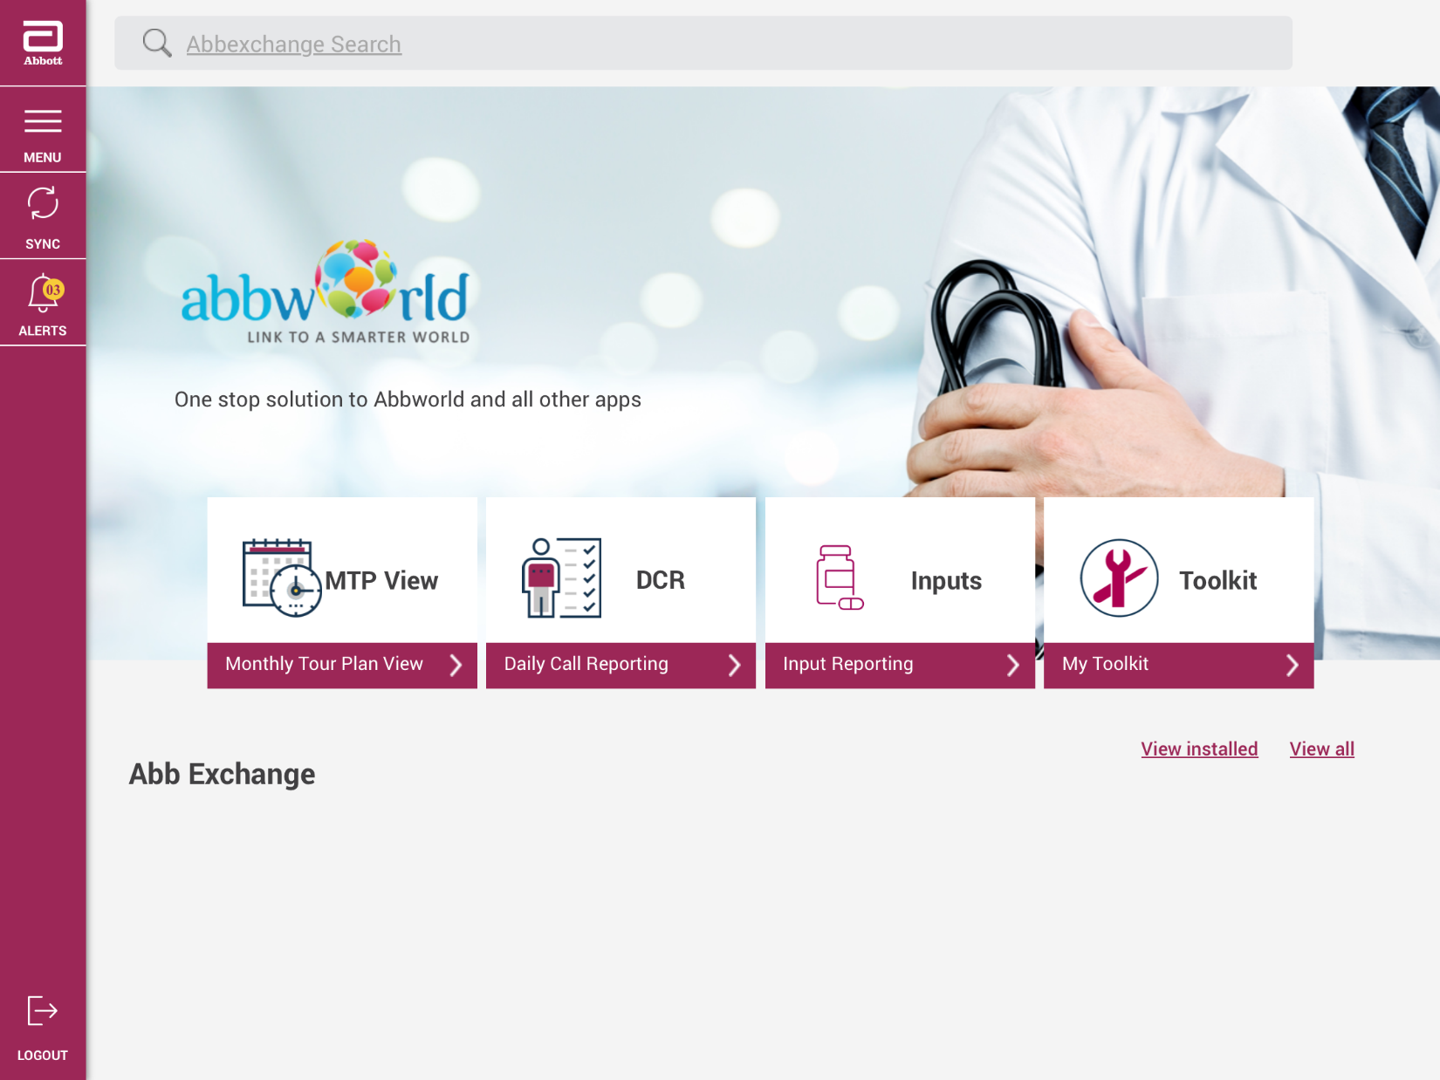
Landing page iPad:

Slide 5
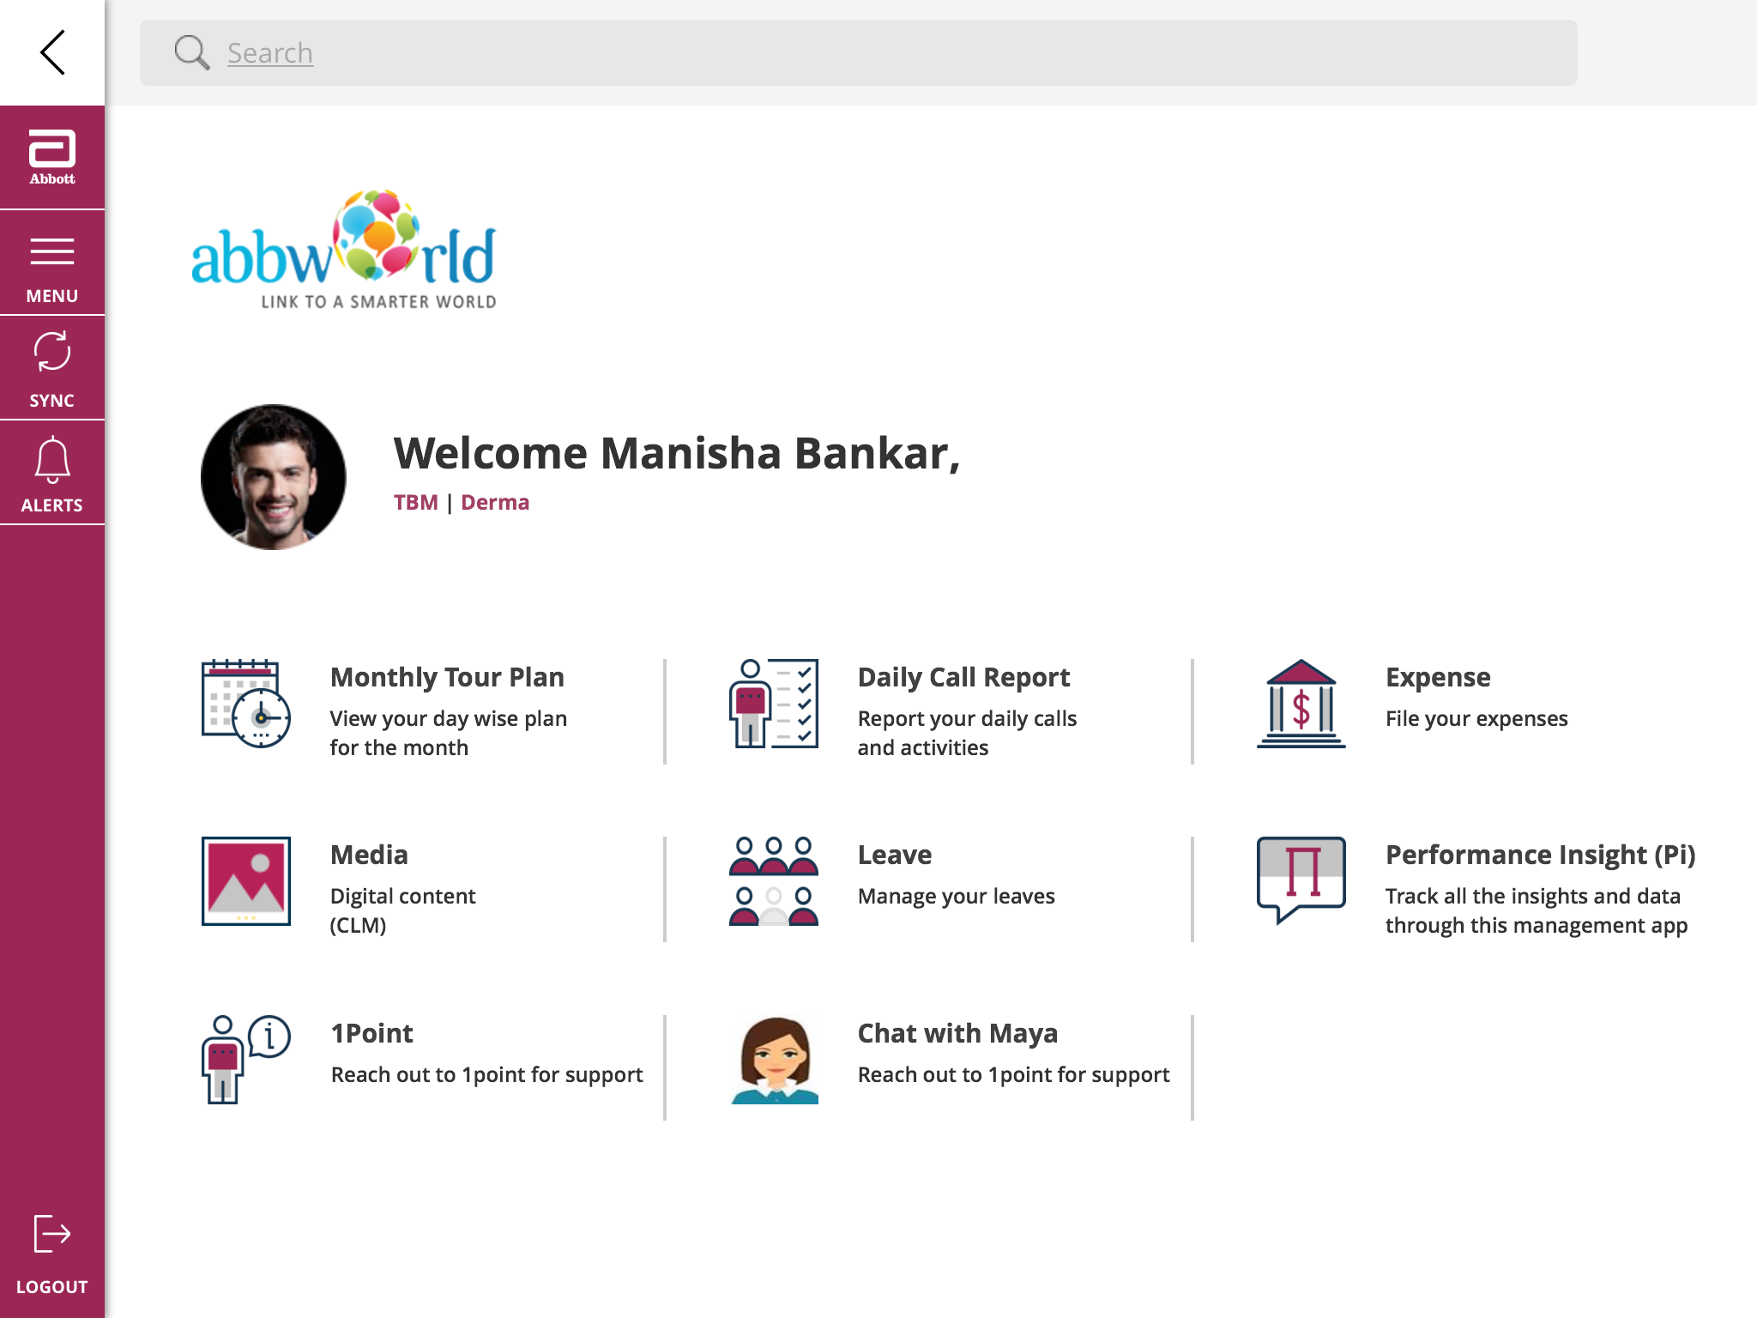
How to access/download the Digital e-Detailing content?
Click on media

Slide 6
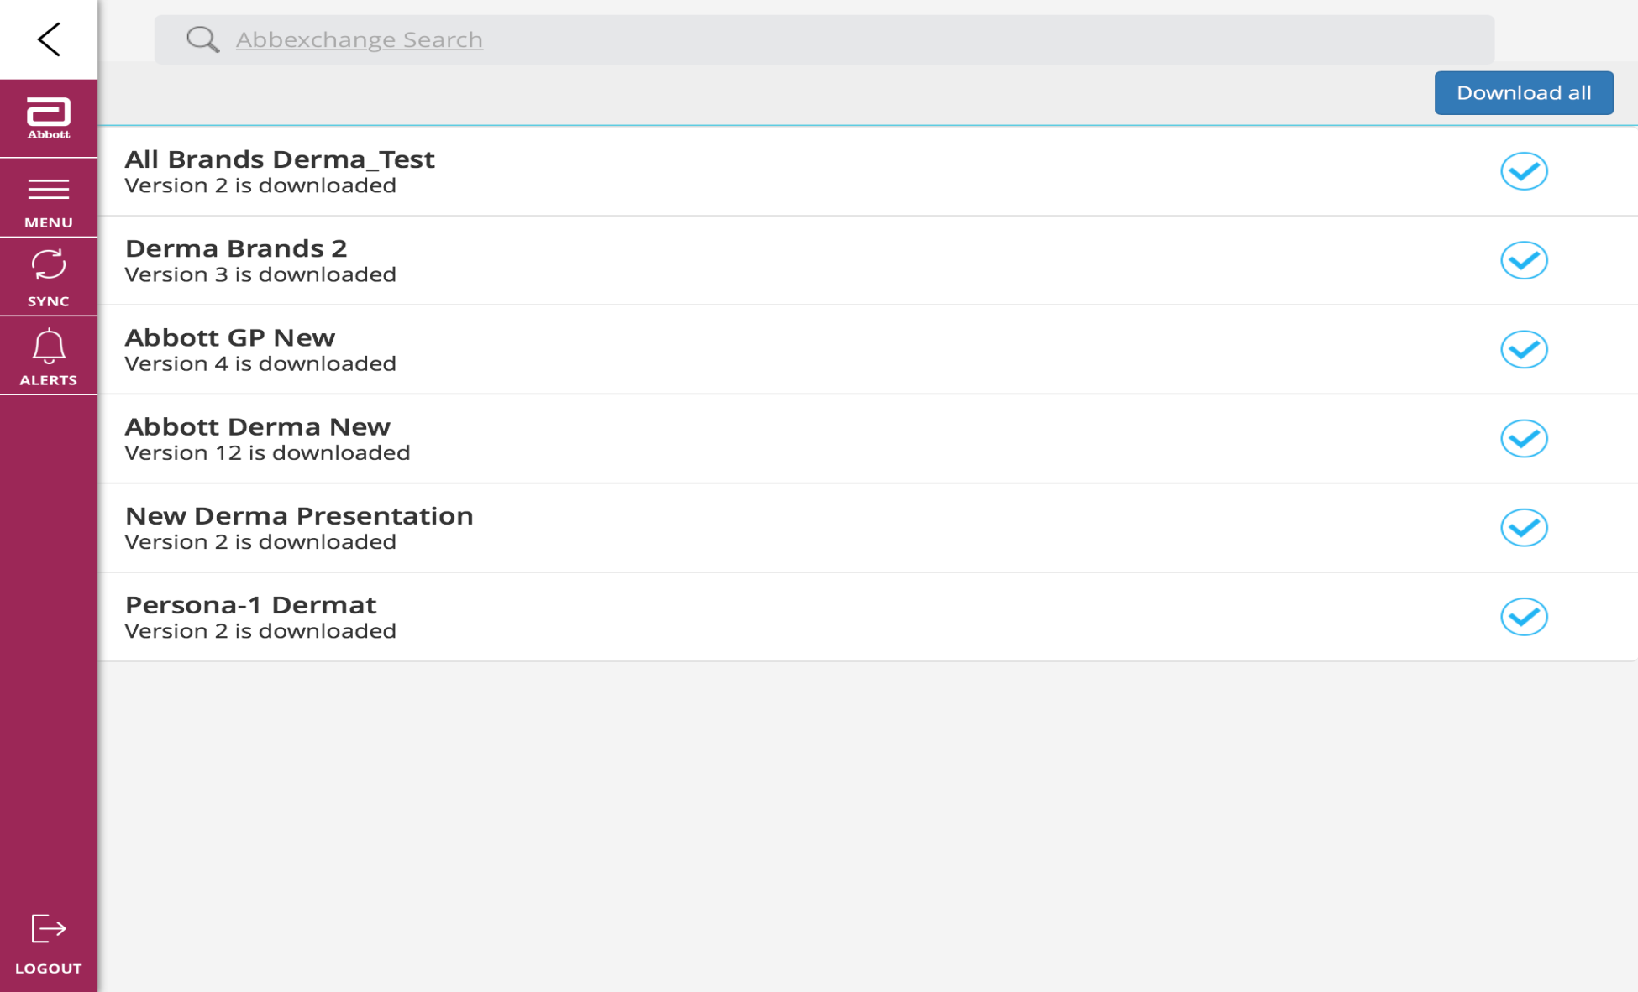
How to access/download the Digital e-Detailing content?
Click on Download all

Slide 7
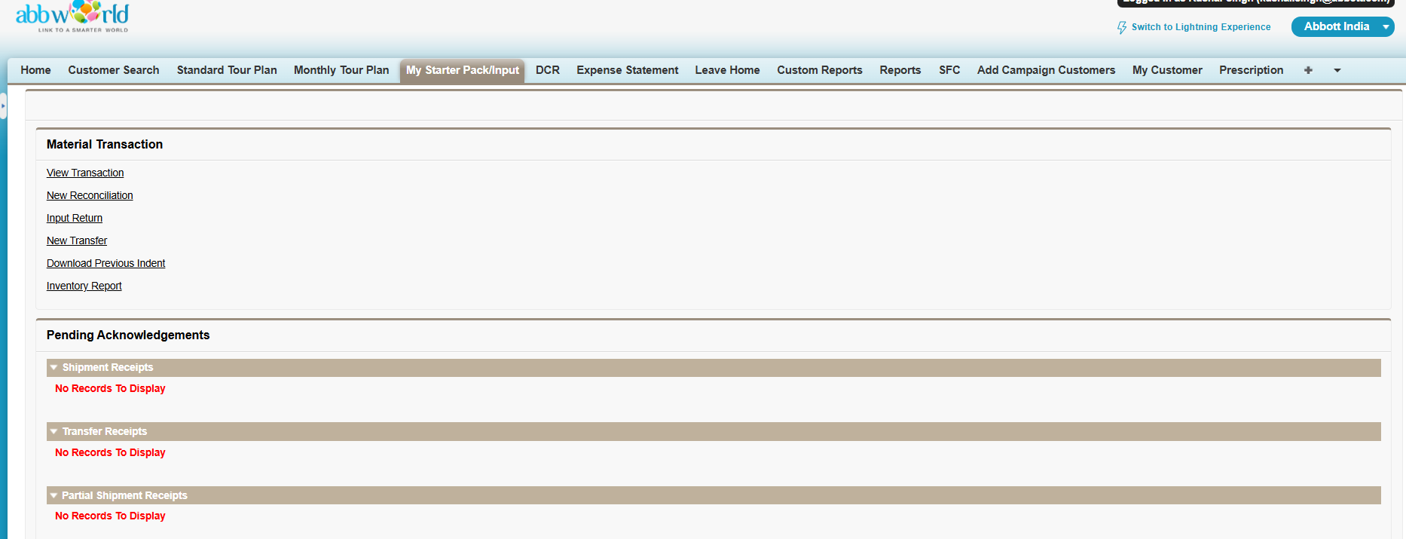
Input Acknowledgement on Abbworld System:
URL: Abbworld.my.salesforce.com

Slide 8
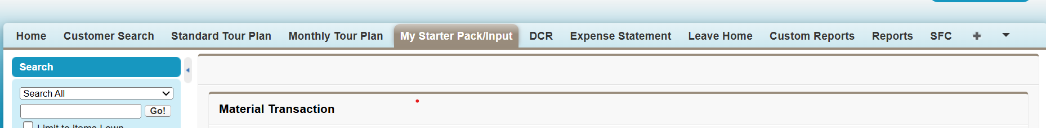
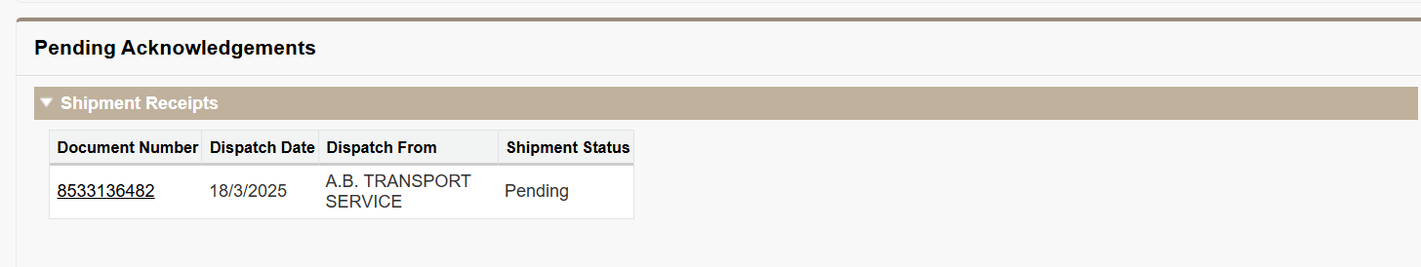
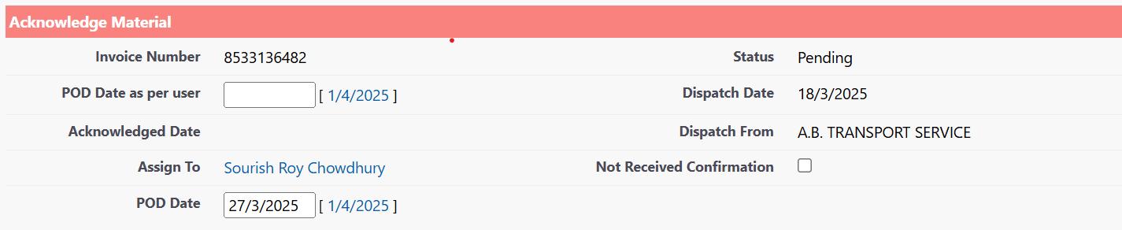
Click on My starter Pack/Input
Input Acknowledgement on Abbworld System:
Click on the My starter Pack/Input.
Go to Pending acknowledge tab and click on the same.
Update the POD date and submit

Slide 9
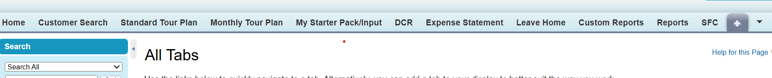
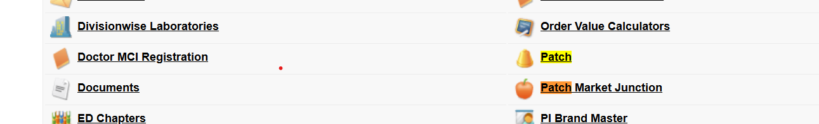
How to create a Patch:
Click on (+) sign
Click on Patch

Slide 10
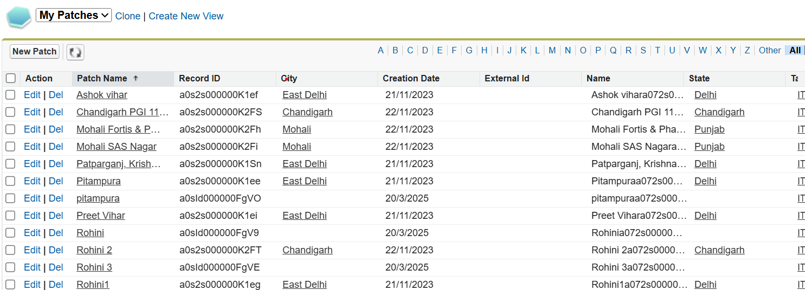
How to create a Patch:
Click on New Patch

Slide 11
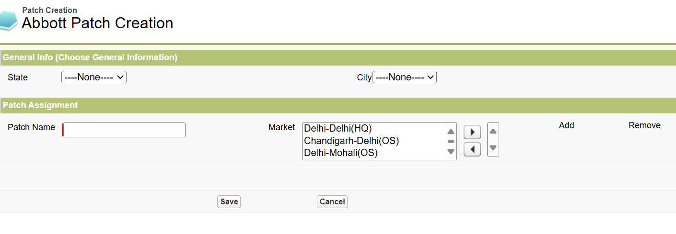
How to create a Patch:
Select City
Select State
2
1
Type your Patch name
Select the Drs
3
4
Select all state and city
Give a patch name and select market and then save.

Slide 12
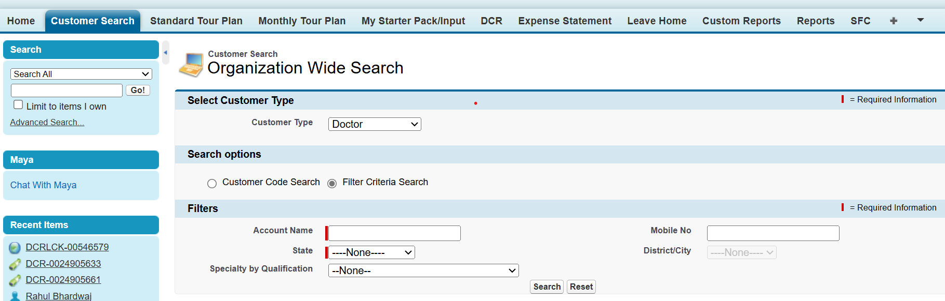
How to add a customer:
1
Click Customer search
Select customer type
2
Search with name
3

Slide 13
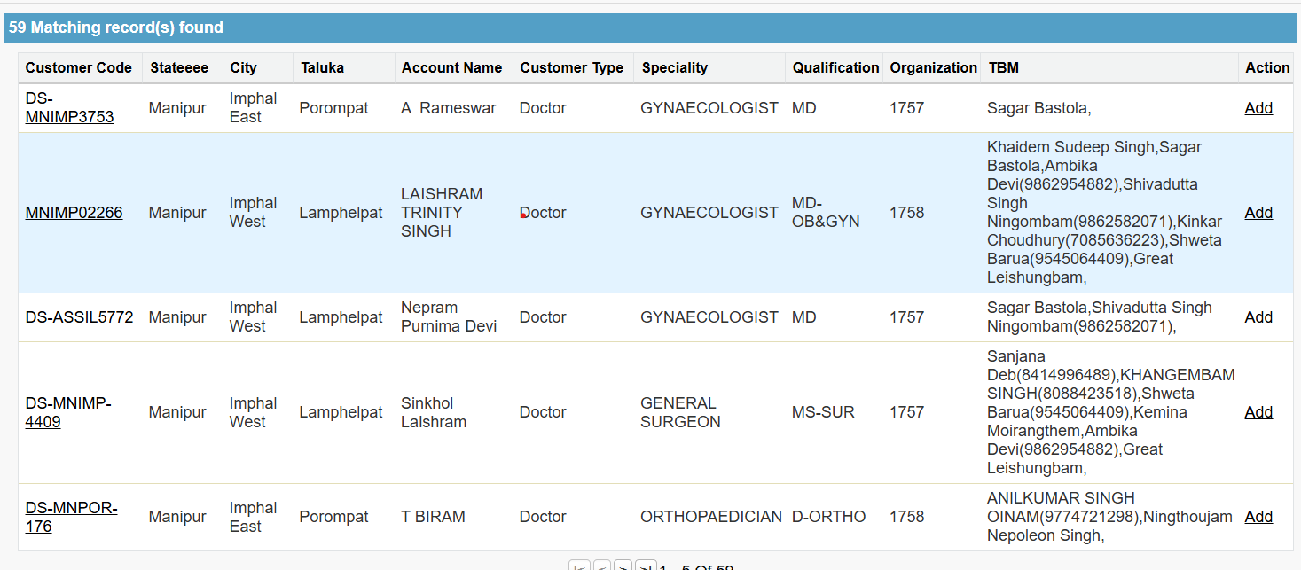
How to add a customer:
Click on add

Slide 14
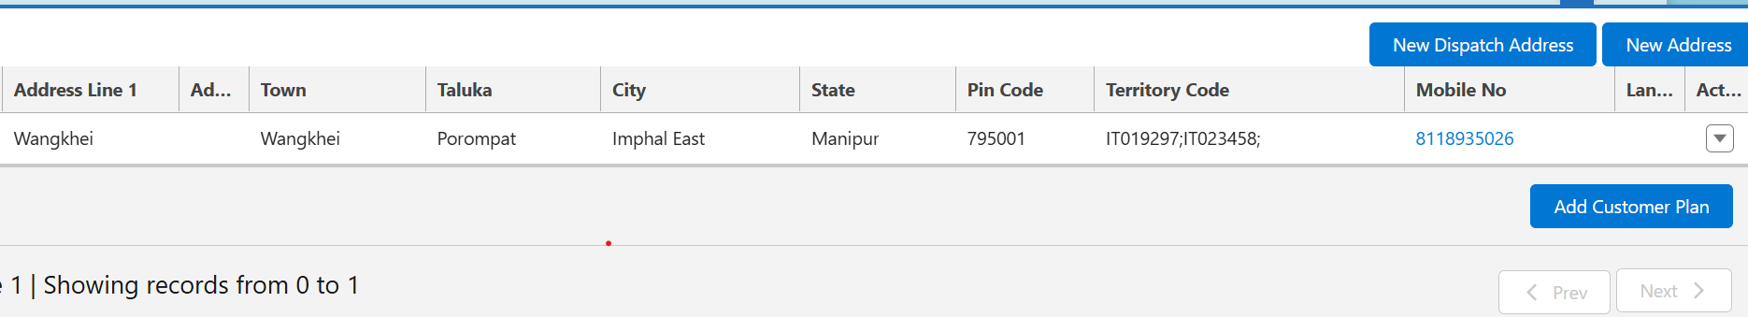
How to add a customer:
Click on add

Slide 15
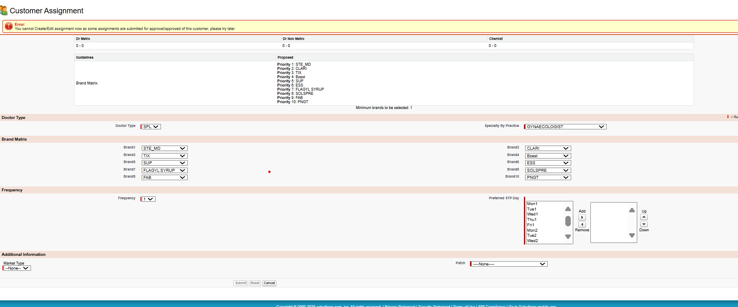
How to add a customer:
Select day
Select Market type
Click on submit
Select patch

Slide 16
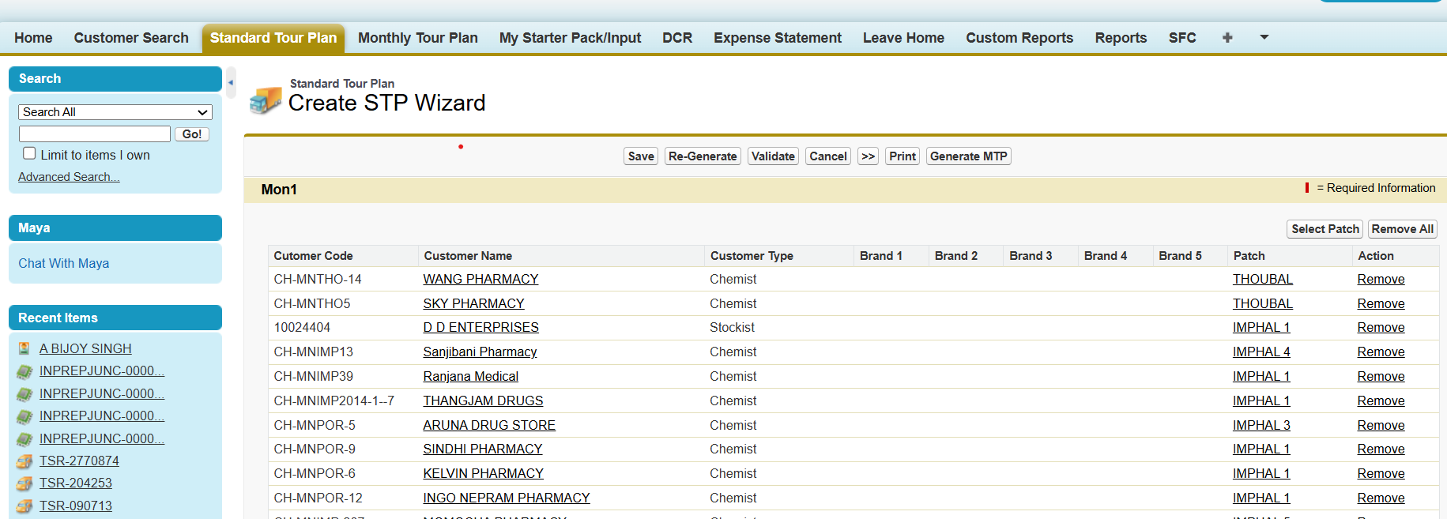
Plan your a STP/MTP:
Click on generate MTP
3
Click on STP
Click on validate
2
Click on Re-Generate
1

Slide 17
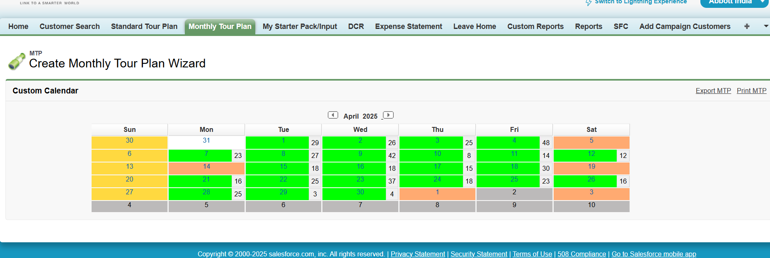
Plan your a STP/MTP:
Click on MTP
Click on date

Slide 18
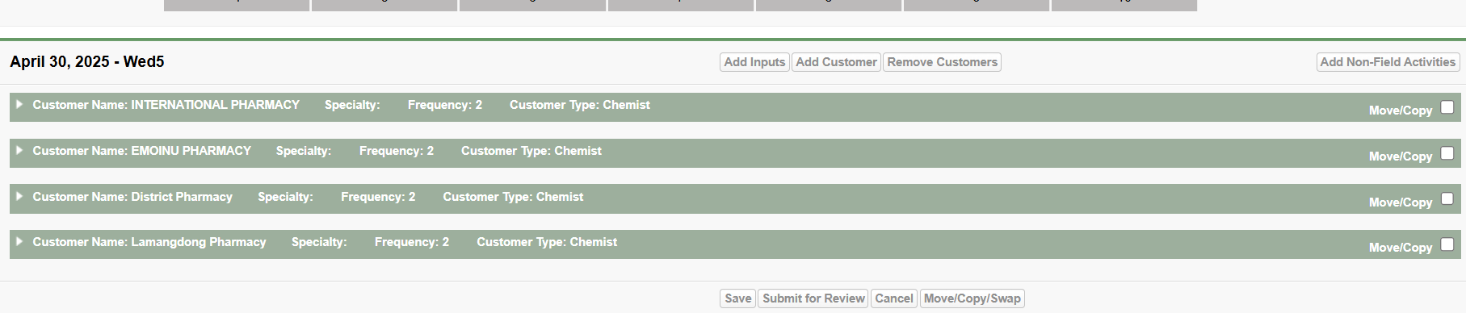
Plan your a STP/MTP:
Check your customer visit list
And click on submit for review
Submit for review

Slide 19
File your Daily Call Reporting (DCR) from here:

Slide 20
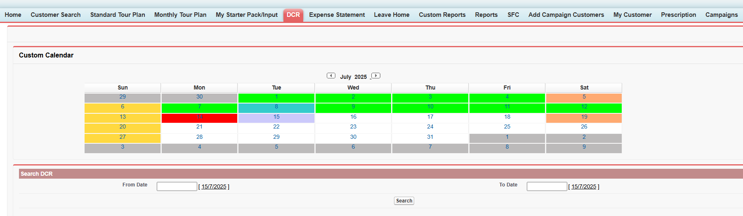
File your Daily Call Reporting (DCR) from here:
You can access the Daily Call Reporting Module from the Landing screen and Abbworld App Home Screen.
Dates highlighted with green dots are the ones already reported, The dates highlighted with “E” are the ones where expense is filed.
Dates highlighted with Red are pending for DCR reporting
Click on the Date to report DCR for the day.
The yellow bar shows the
- No. of calls done vs Planned
No. of doctors covered vs Planned
No. of field working days done vs planned
Select the date of DCR

Slide 21
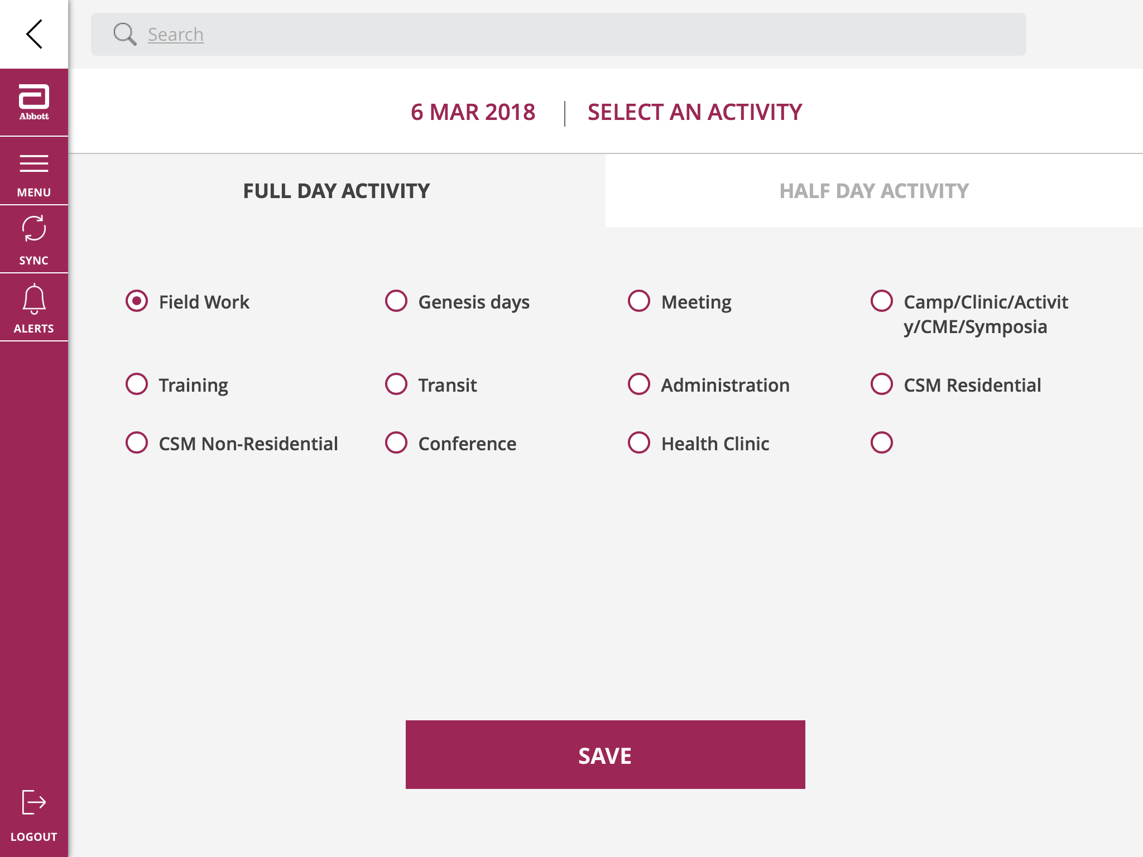
Activity selection in Daily Call Reporting is now simple - Full day:
The Activity selection screen has default selection of Full Day Activity and the activity type as Field Work
You can select any of the activity by clicking on the corresponding radio button
Then click on Save

Slide 22
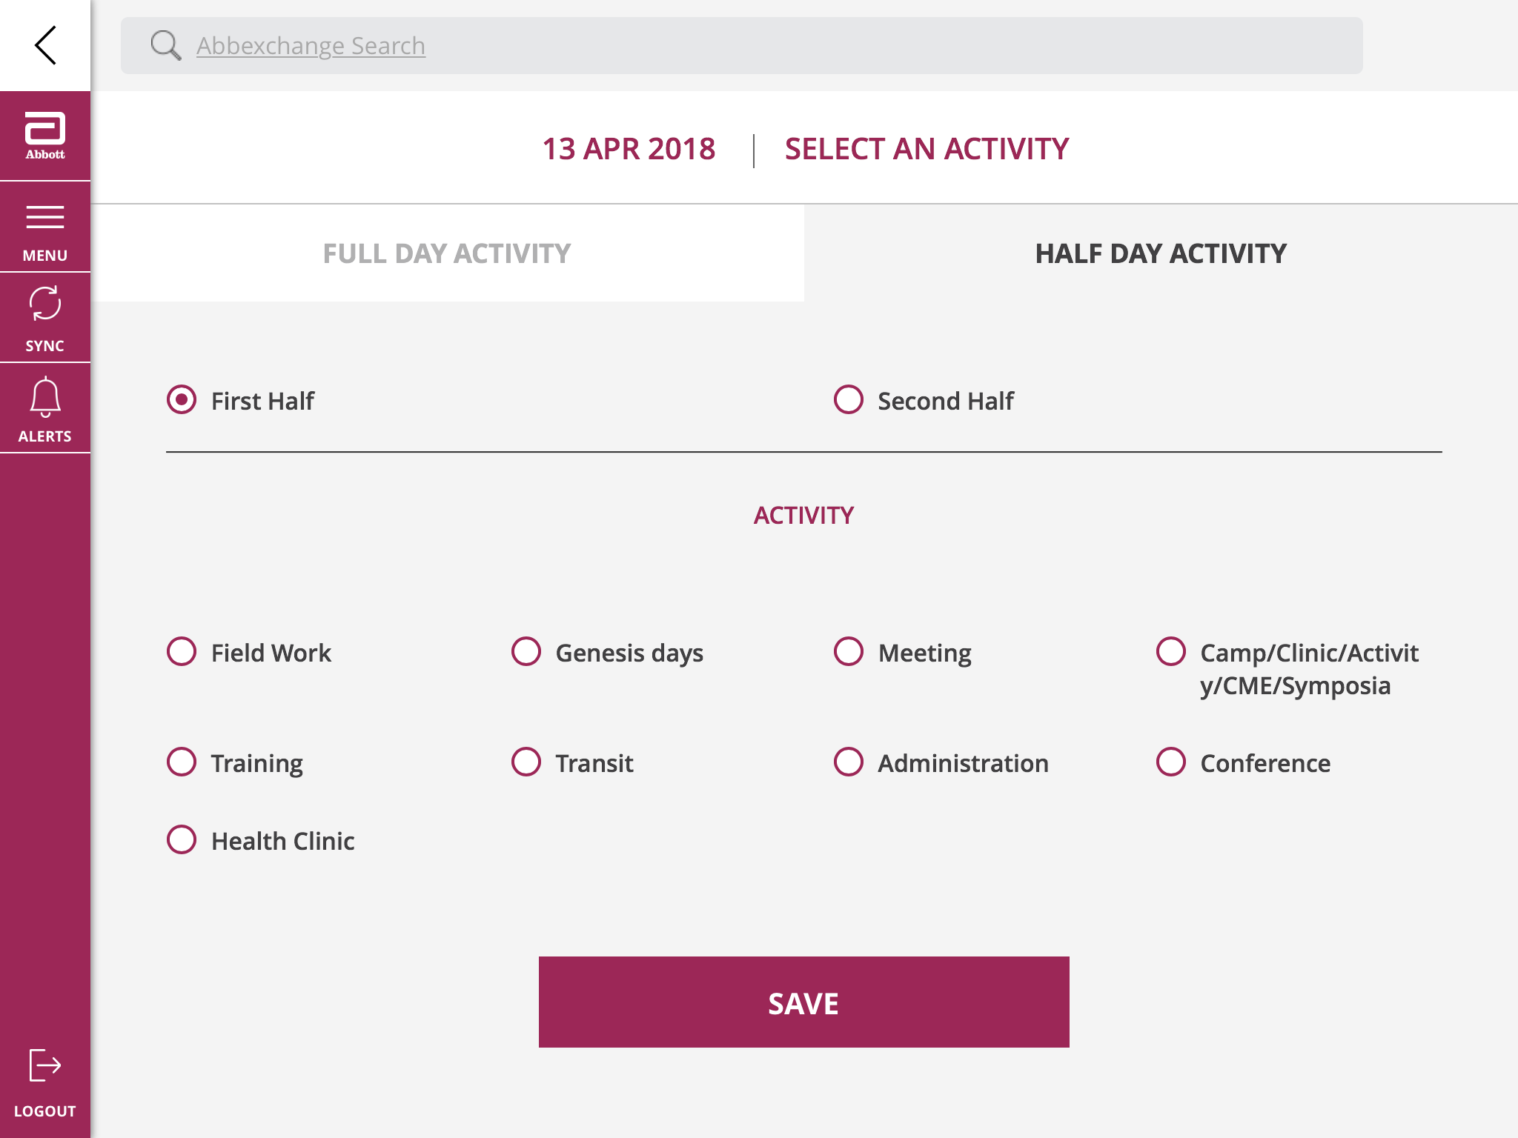
Activity selection in Daily Call Reporting is now simple - Half day:
The Activity selection screen has option of selecting Half Day Activity and further option of first half and second half
The activity type can be selected as per requirement
Then click on Save

Slide 23
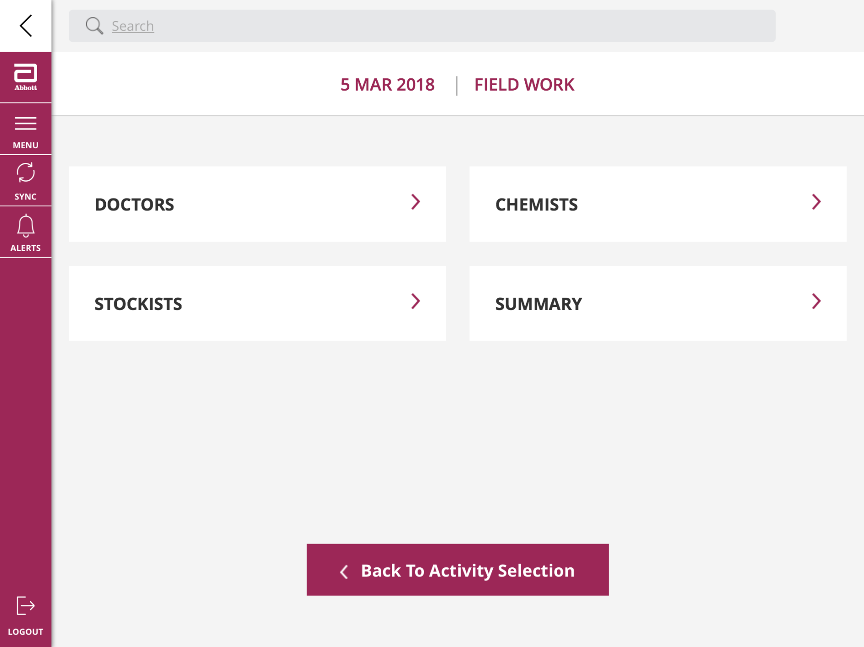
How to report a Doctor in DCR?
Click on Doctors to report doctor meetings
Similarly, you can click on Chemists and Stockiest to report respective meetings
To change the activity selection, click on the “Back to Activity Selection” tab

Slide 24
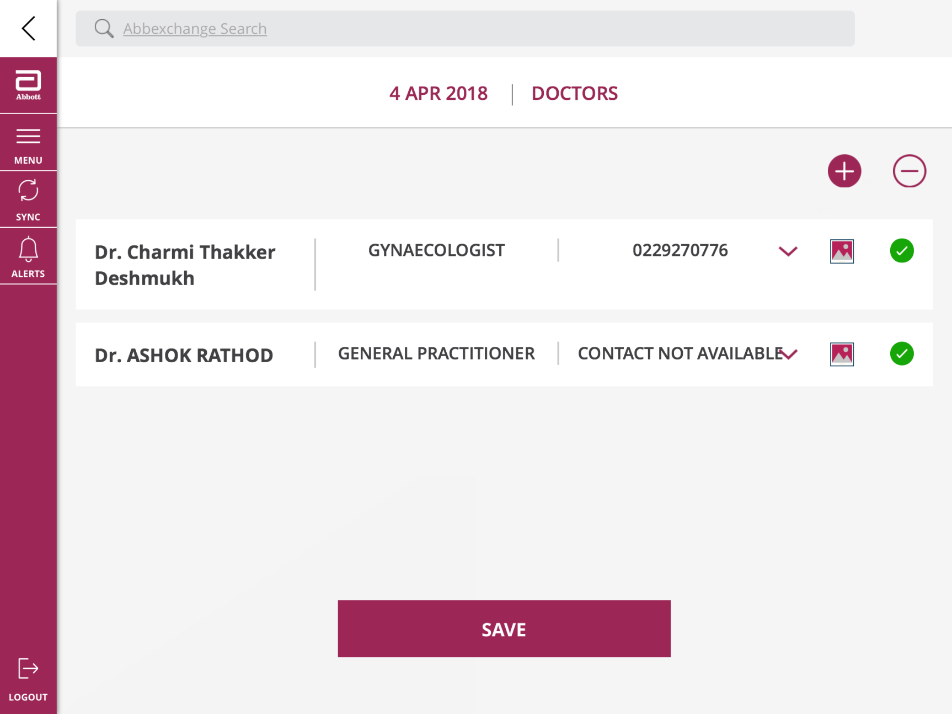
List of Doctors planned in MTP reflecting in DCR page:
You can see the list of Doctors planned in MTP for the day
To add Doctors met in the day but not part of the MTP click on the (+) sign
To remove Doctors planned in the day but not met click on the (-)
Media Tab : once we click on media tab user will be directed to content-based presentation
Down Arrow shows the details where user will be able to view doctor persona.
User can also report prescription, Post call objectives.
User can also view last call comments.

Slide 25
How to Add doctors met in the day but not planned in MTP?
To add Doctors met in the day but not part of the MTP click on the (+) sign
To remove Doctors planned in the day but not met click on the (-)
Click on the media icon if you want to report CLM call on DCR.

Slide 26
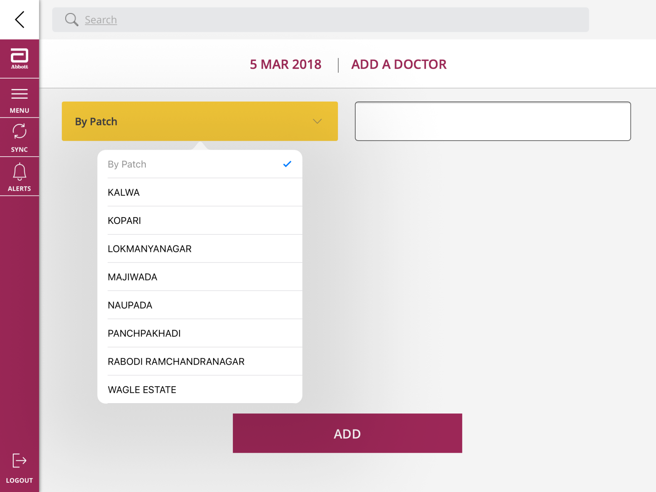
How to Add doctors met in the day but not planned in MTP?
Add Doctor by patch by selecting the Patch from drop down list

Slide 27
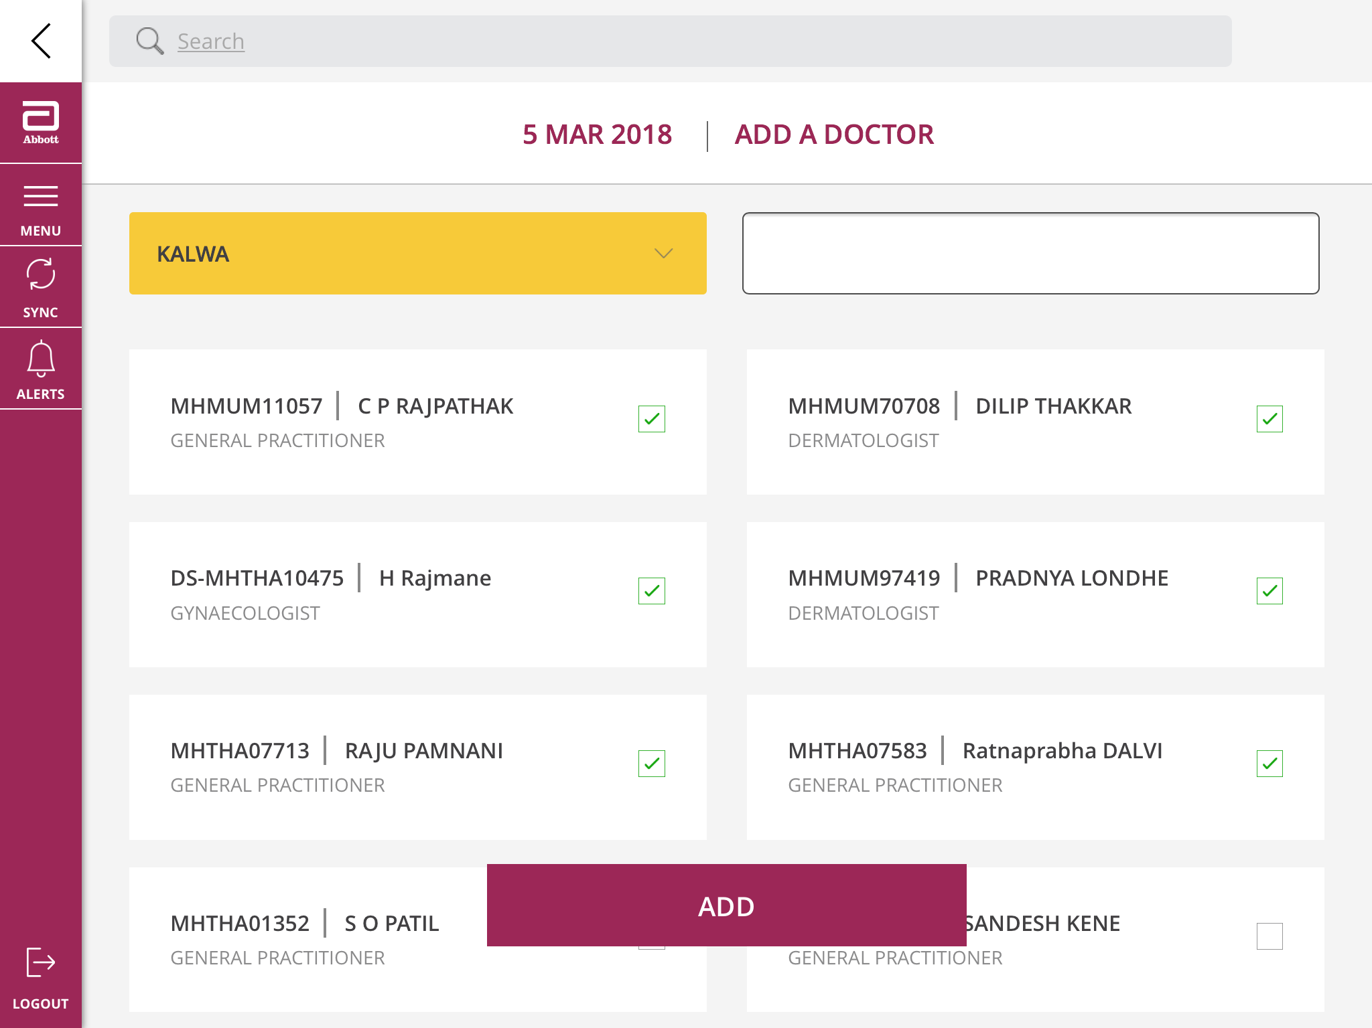
How to Add doctors met in the day but not planned in MTP?
Select doctors & click on ADD
You can also search a doctor by name in the search option

Slide 28
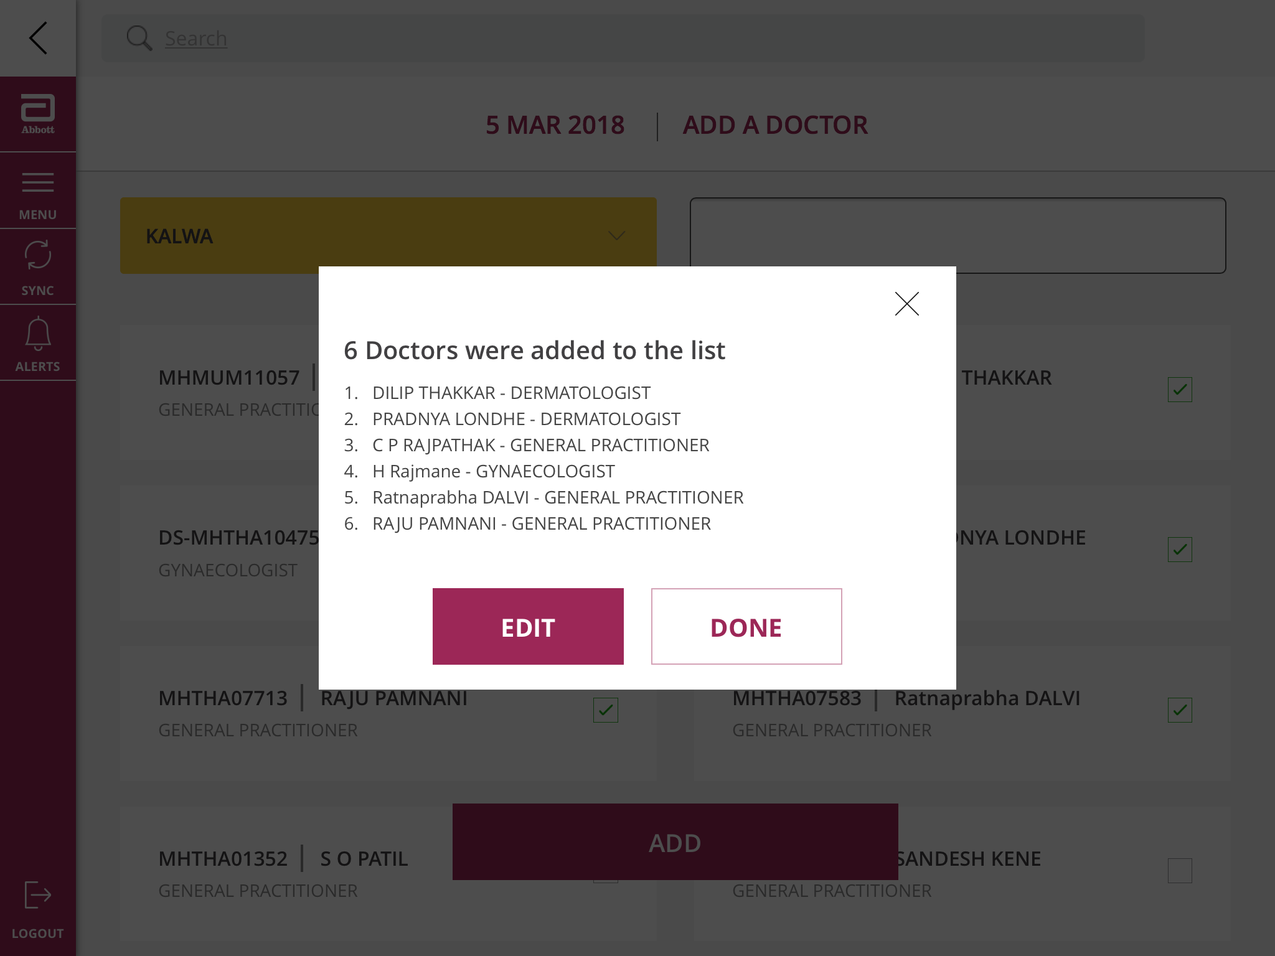
How to Add doctors met in the day but not planned in MTP?
Once you click on ADD app will show you this screen
Click on DONE after verifying the doctor selection

Slide 29
Doctor Reporting Screen:
To report a Doctor Meeting click on ( ) sign to report JFW and Rx data for the Doctor

Slide 30
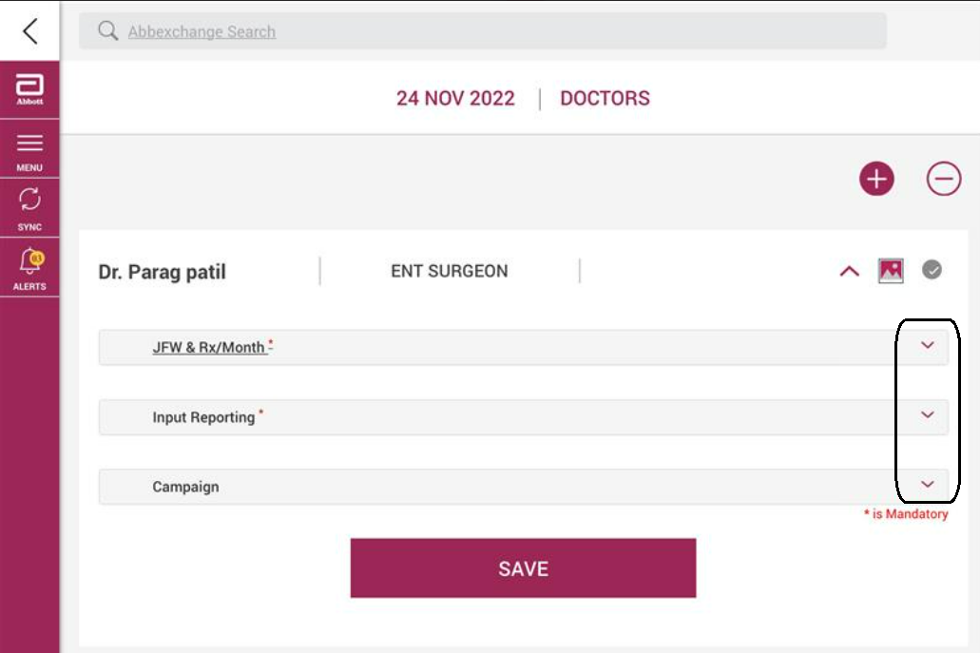
Doctor Reporting Screen:
After detailing, User needs to click on drop down mark & select mandatory details which are available under doctor section
1) JFW & RX/Month (Mandatory)
2) Input Reporting (Mandatory)
3) Campaign (Not Mandatory)
User needs to click on every dropdown button to view & update details

Slide 31
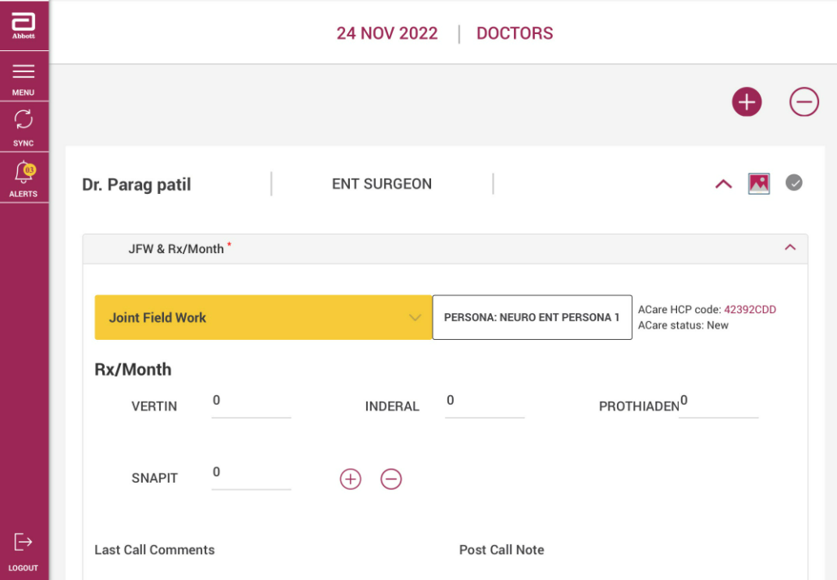
Doctor reporting screen – JFW selection & Rxn entry:
User can now see the JFW selection an Rx update section
1. To see the list of JFW options click on
( ) and then report JFW
2. Enter Rxn for all Brands.
Then click on Save
The ( ) sign corresponding to the Doctor turns green indicating JFW and Rxn entry is completed and Successfully saved for the Doctor.
Similarly, you can report all the Doctors for the day

Slide 32
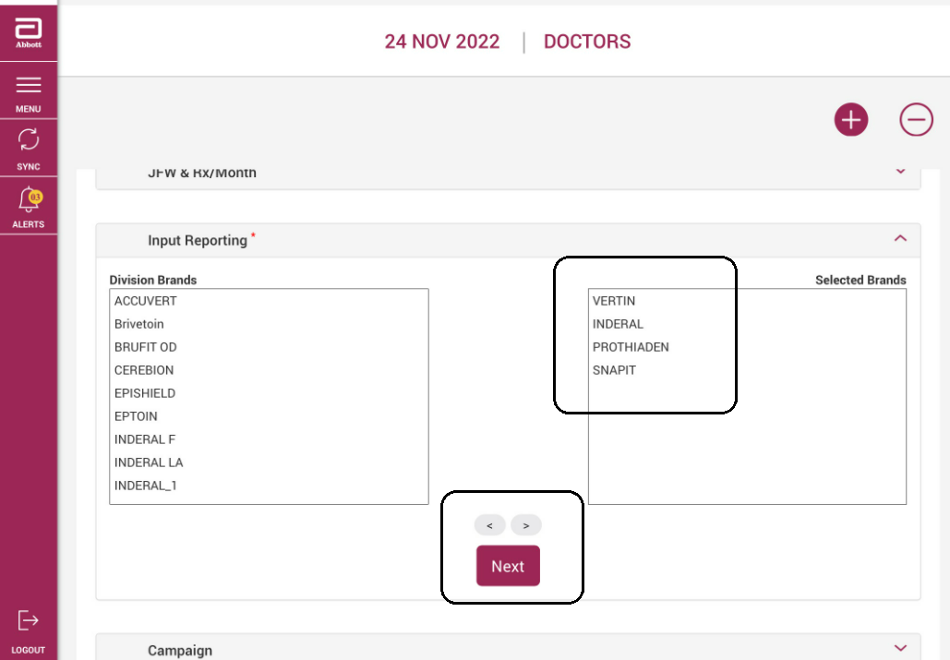
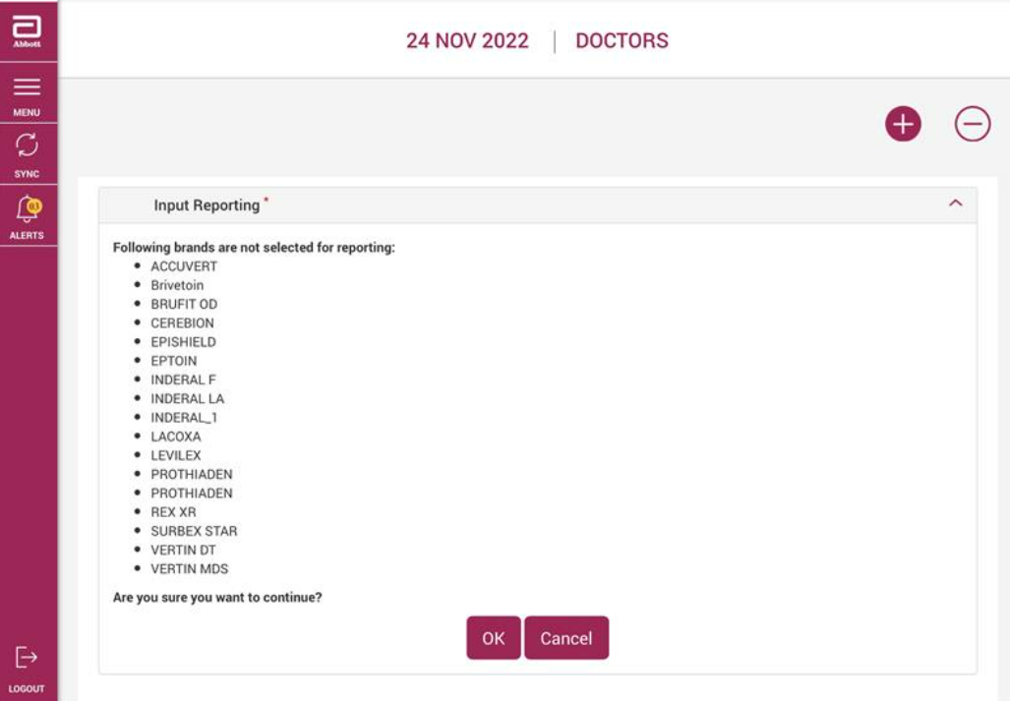
Doctor reporting screen – JFW selection & Rxn entry:

Slide 33
Doctor reporting screen – JFW selection & Rxn entry:
User needs to select brands from division brands section wherever they have distributed materials to doctor
Brands can be move from left to right by selecting arrow & then click on Next button
After selecting brands & clicking on Next button, User needs to give a confirmation by clicking on Ok button

Slide 34
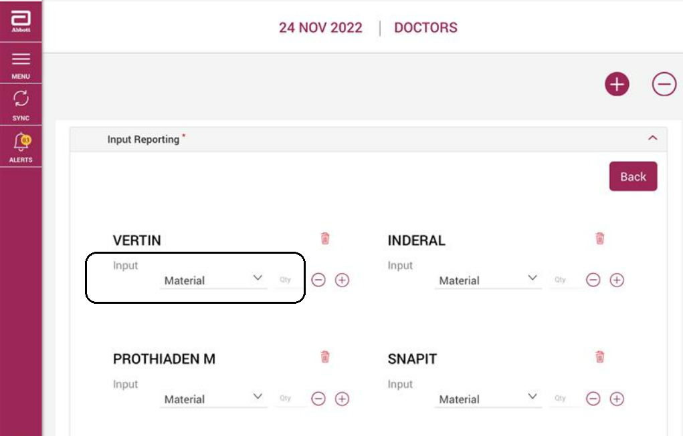
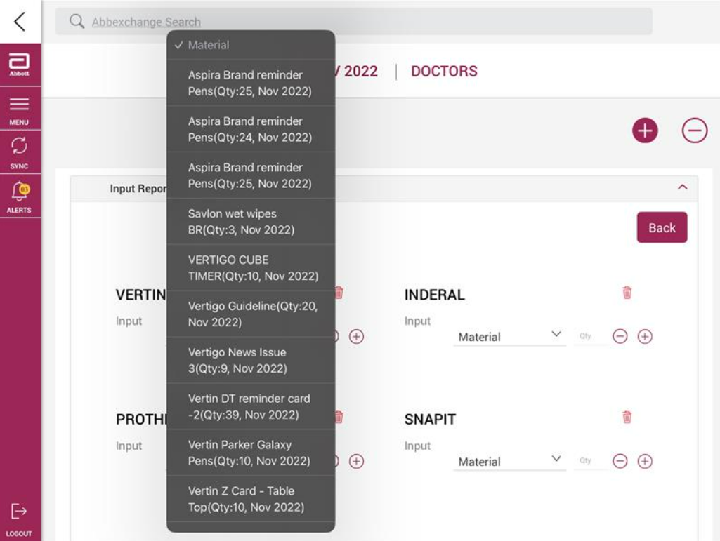
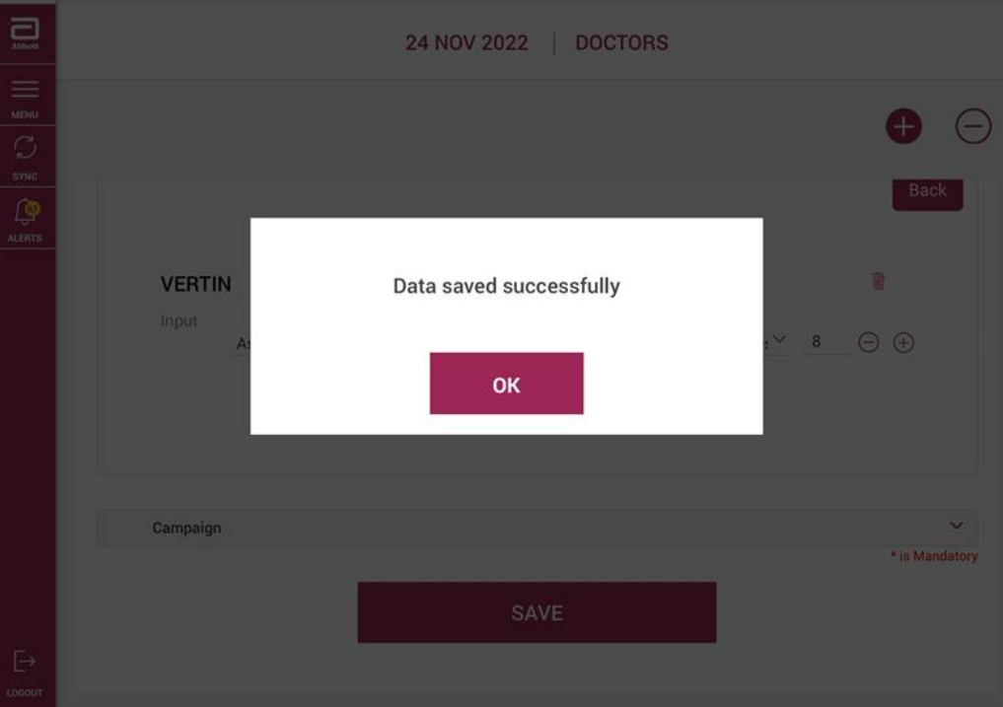
Doctor reporting screen – Input quantity reporting:
User can report your materials and quantity against each of the Brands given to the Doctor.
To report more than 1 input against each brand click the (+) sign. To remove wrongly added inputs click the (-) sign
After completing Input Reporting, click “SAVE” button

Slide 35

How to Add Chemists met in the day but not planned in MTP?
Add Chemists by patch by selecting the Patch from drop down list

Slide 36
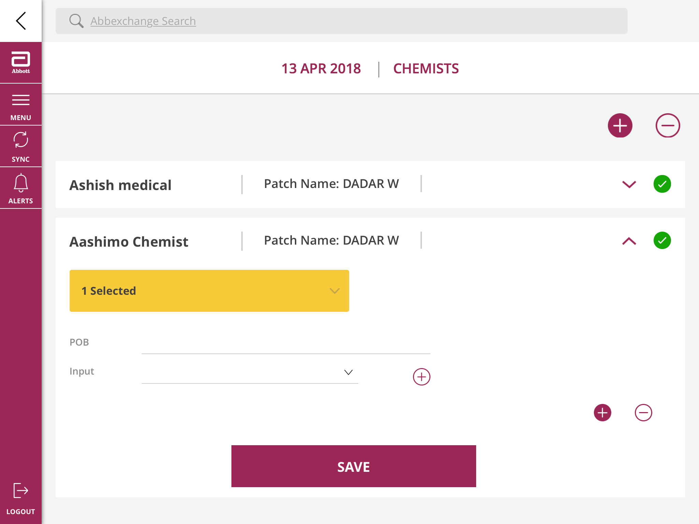
How to Add Chemists met in the day but not planned in MTP?
To add Chemists met in the day but not part of the MTP click on the (+) sign
To remove Chemists planned in the day but not met click on the (-)

Slide 37
List of Chemists planned in MTP reflecting in DCR page:
You can see the list of Chemists planned in MTP for the day
To add Chemists met in the day but not part of the MTP click on the (+) sign
To remove Chemists planned in the day but not met click on the (-)
Clicking on Down Arrow will provide options to add POB and also report inputs

Slide 38
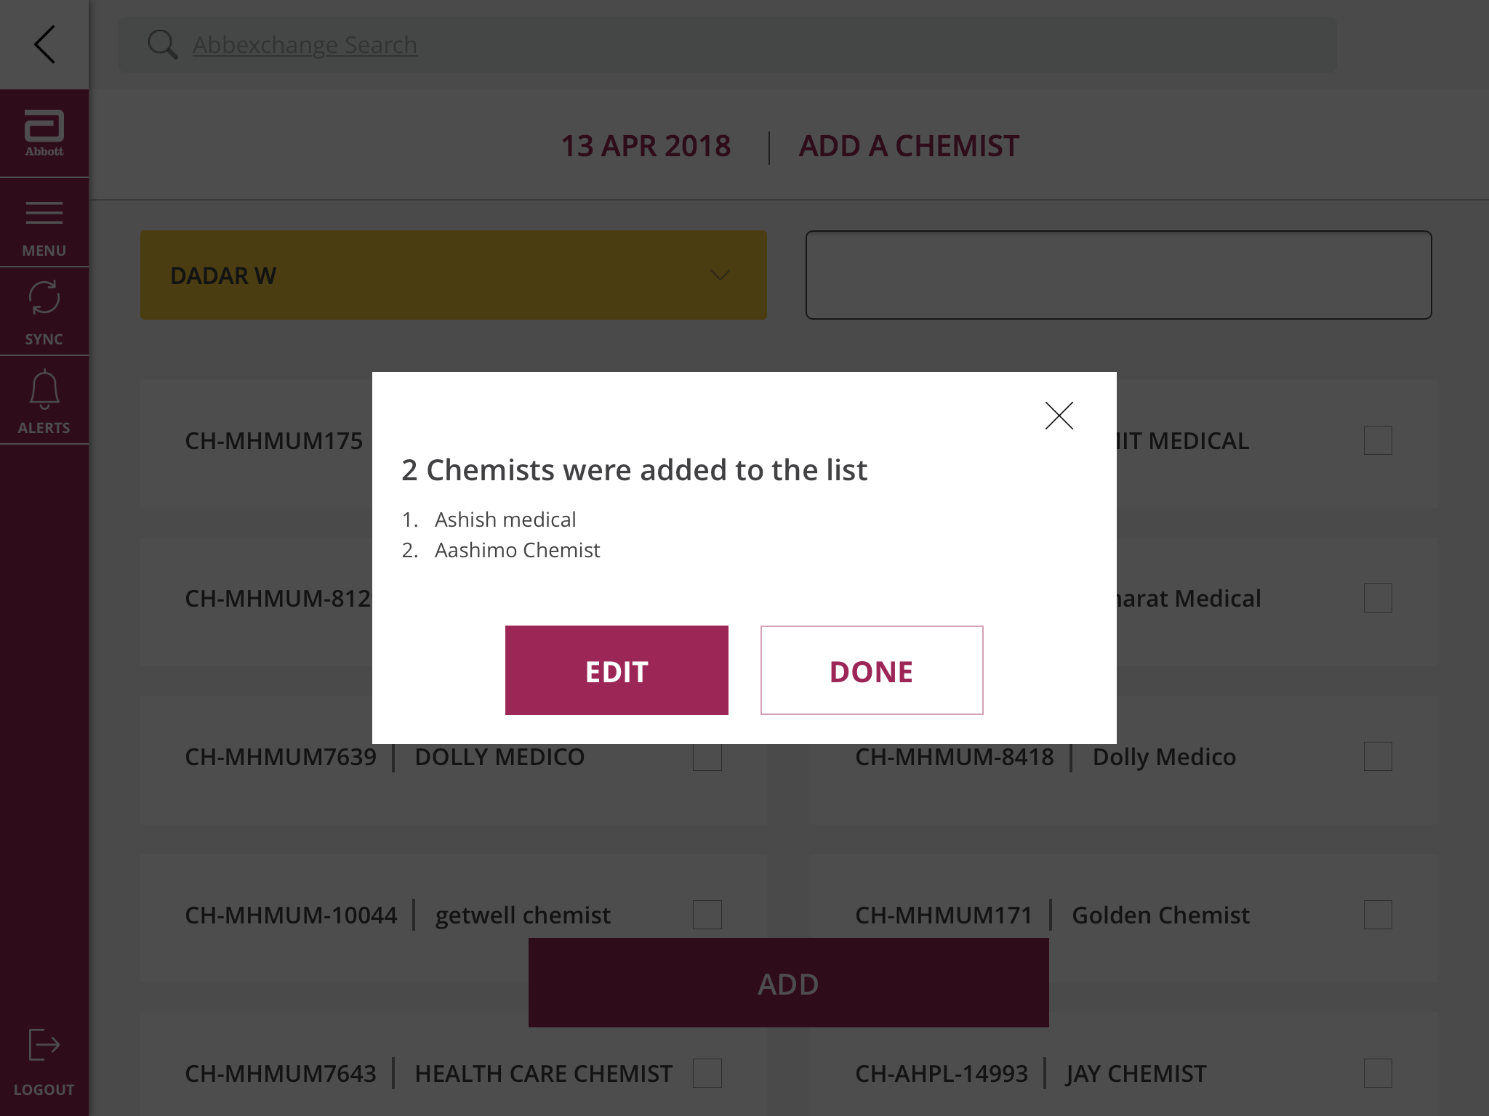
How to Add Chemists met in the day but not planned in MTP?
Once you click on ADD app will show you this screen
Click on DONE after verifying the Chemist selection

Slide 39
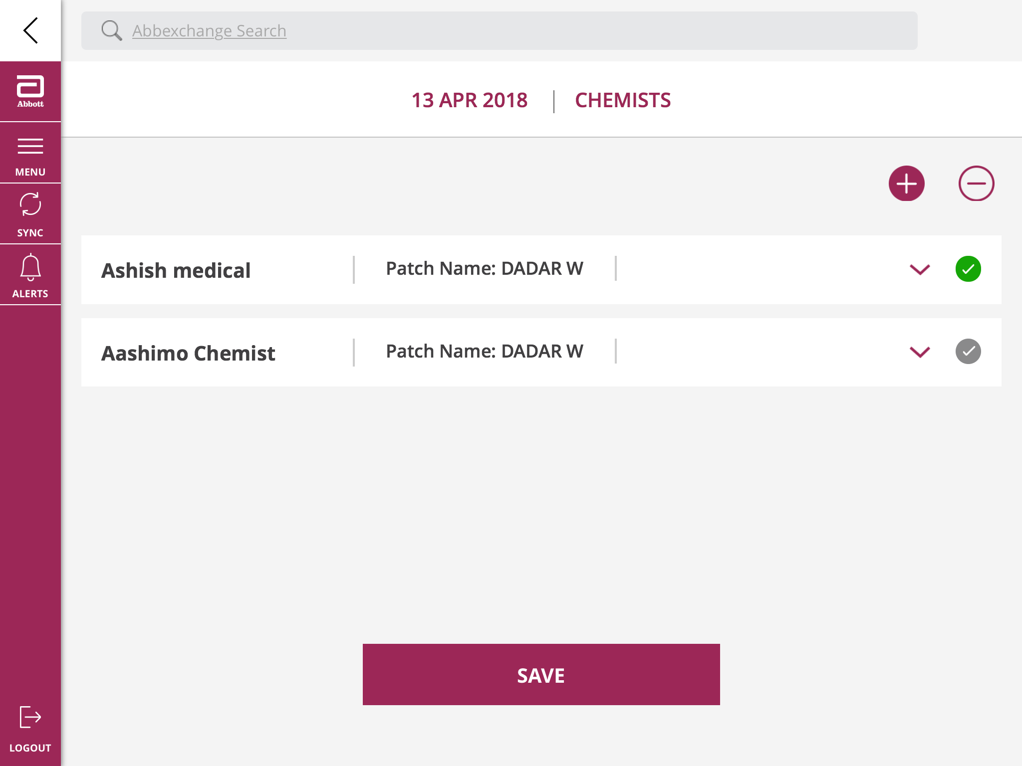
DCR Summary and Final Submission:
Click Save after all the visits are reported so that they are sent to the ‘SUMMARY’ tab

Slide 40
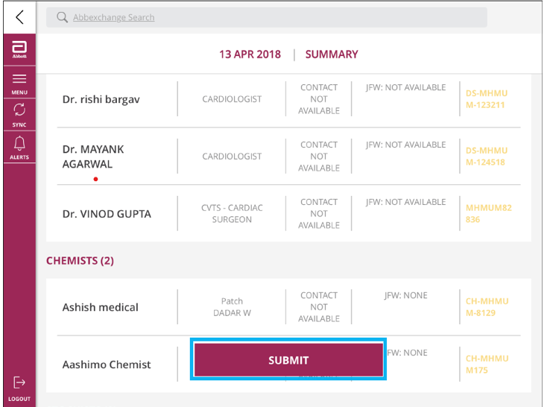
DCR Summary and Final Submission:
Check all your customers and submit.

Slide 41
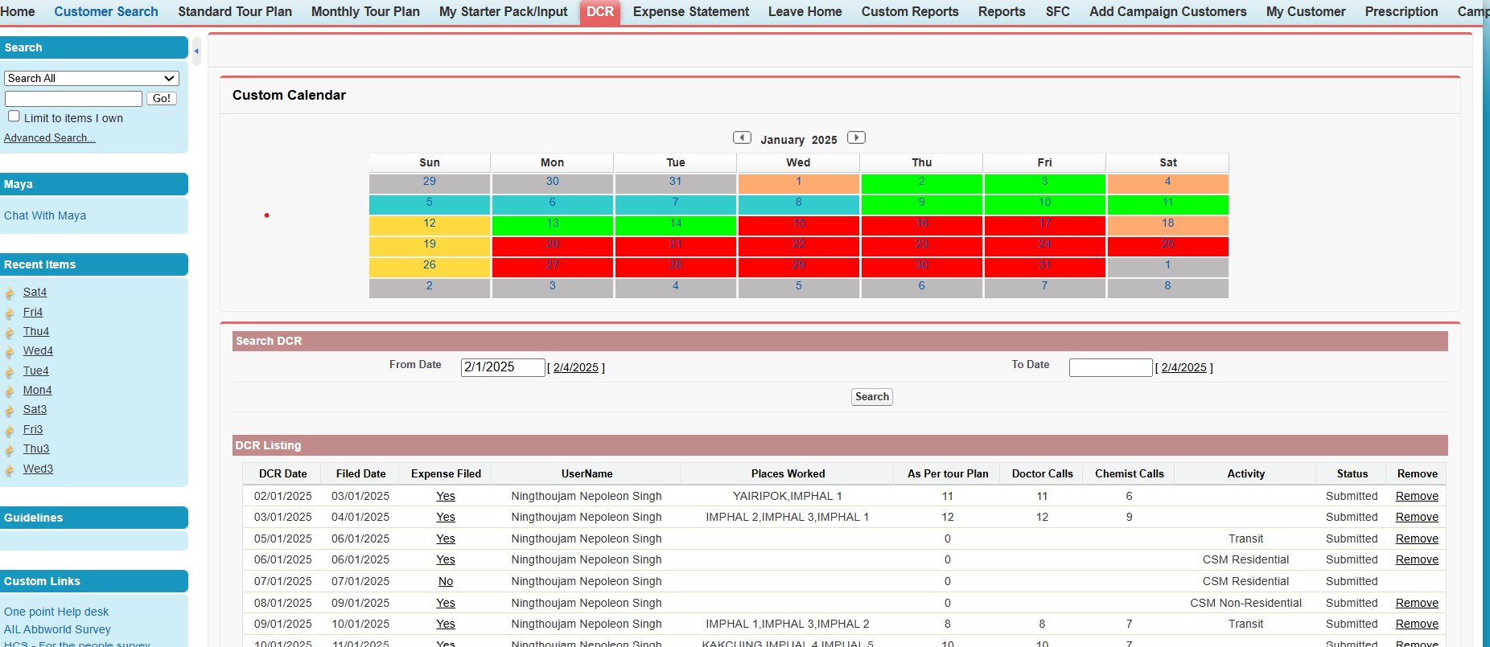
How to file expense for the day:
Select DCR date
Click on No

Slide 42
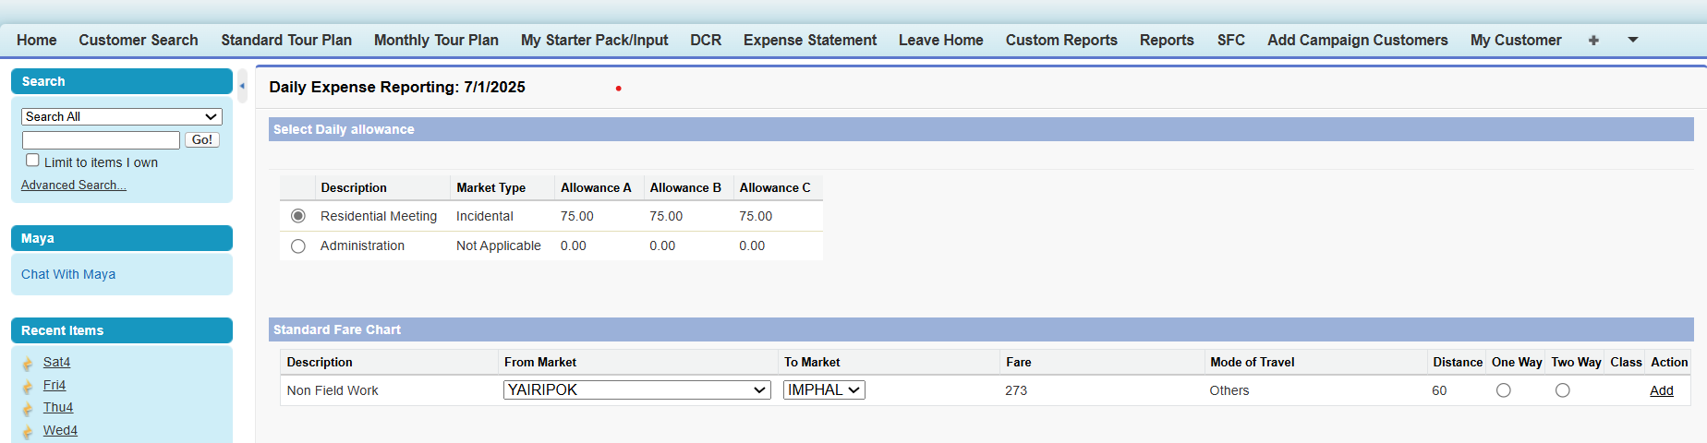
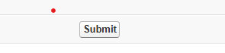
How to file expense for the day:
Select Description
Submit

Slide 43
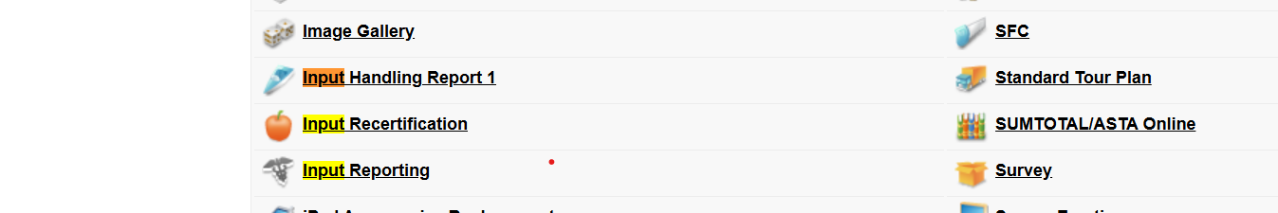
How to report your input:
Click on (+) sign

Slide 44
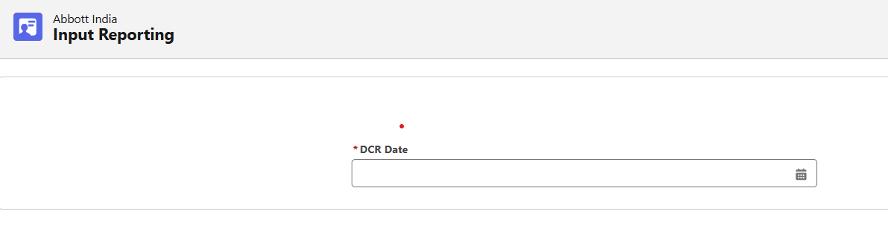
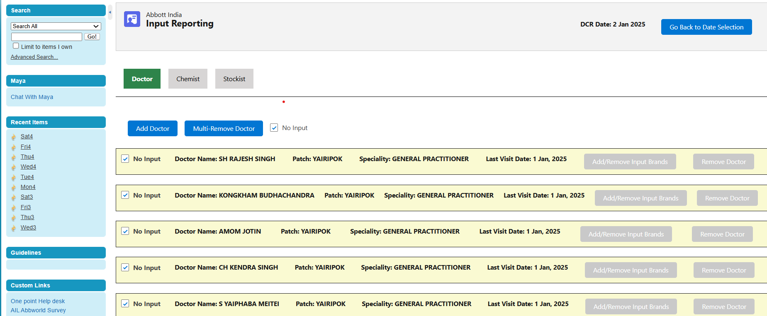
How to report your input:
Add Doctor
Click on no put if there is no input

Slide 45
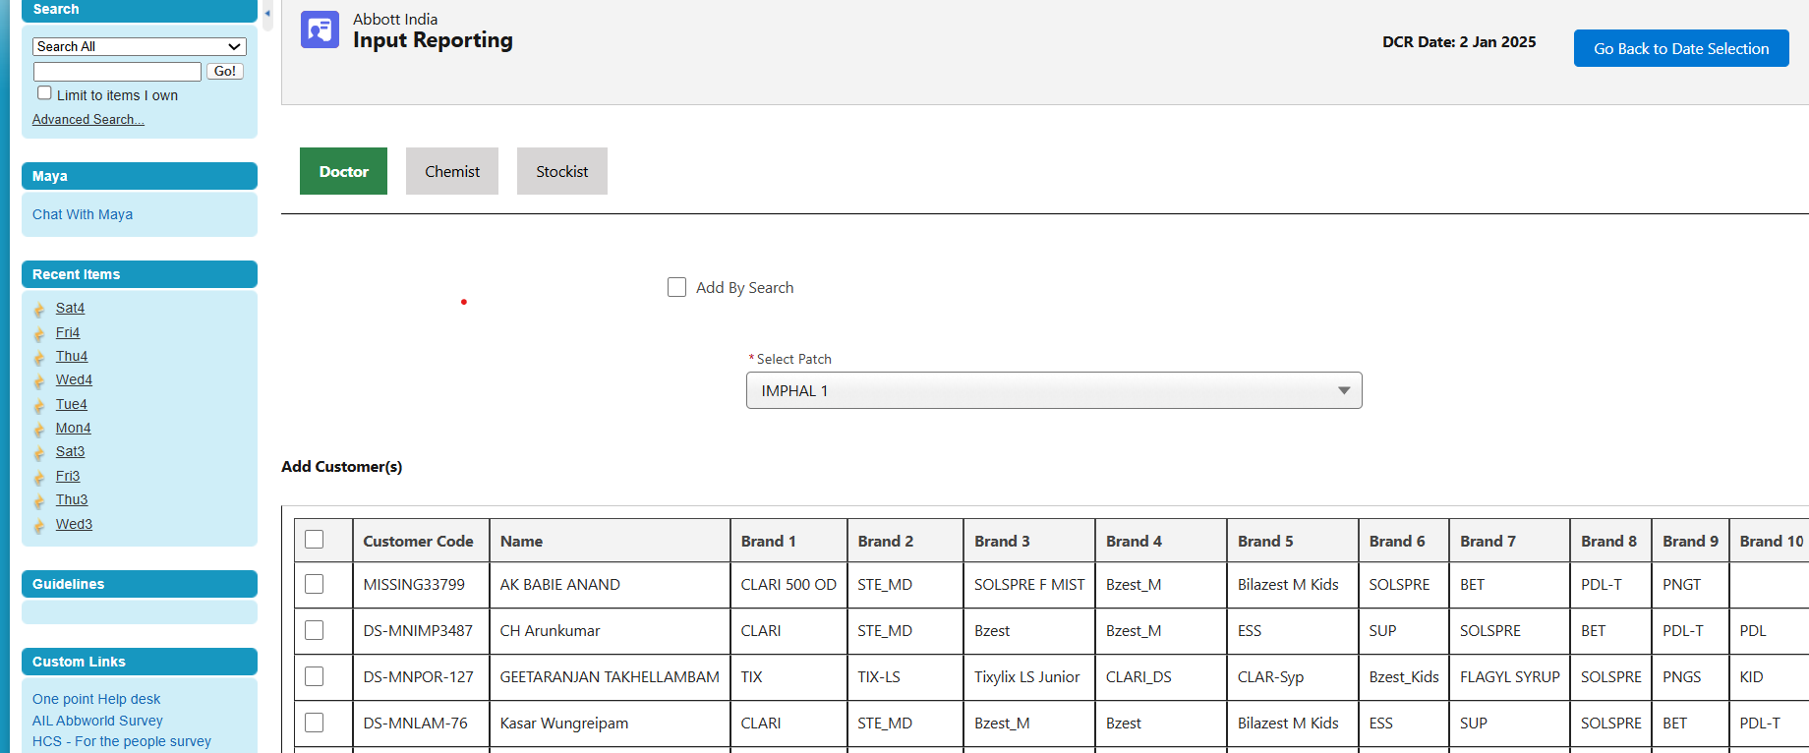
How to report your input:
Select Patch
Select Doctors

Slide 46
How to report your input:
Select Patch
Select Doctors

Slide 47
How to report your input:
Select Patch
Select Doctors

Slide 48
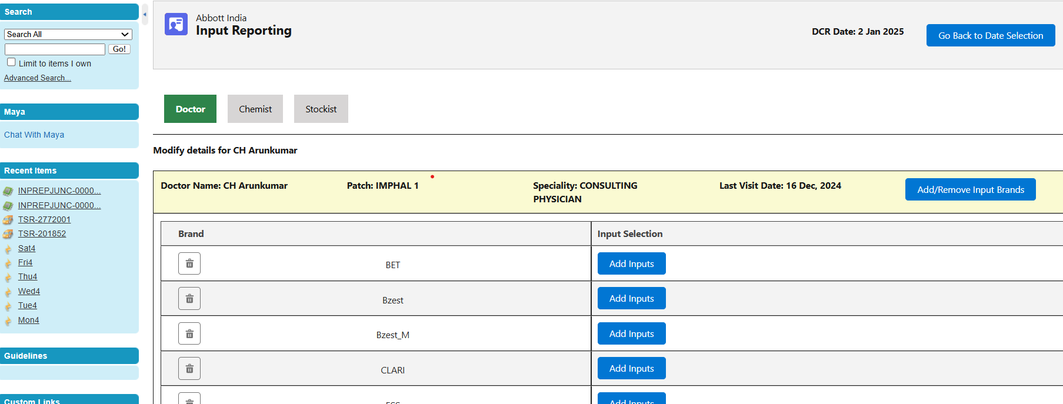

How to report your input:
Add inputs

Slide 49
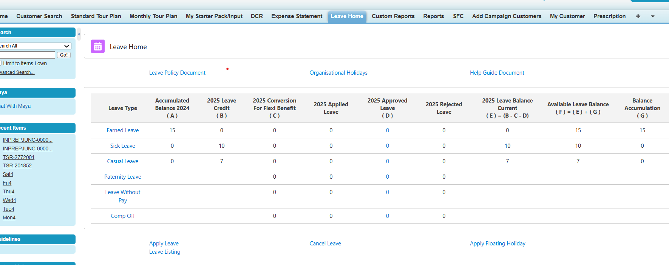
How to apply leave:
Click on Leave Home

Slide 50
How to apply leave:
Click on Leave Home
Click on apply leave

Slide 51
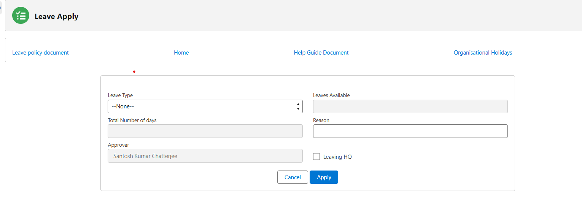
How to apply leave:
Click on Apply

Slide 52
Sample Request:
Build sample request module on Abbworld, eliminating need for multiple platforms /apps for the TBM.
Samples would be directly dispatched to the HCPs from integrated promo hub (IPH).

Slide 53
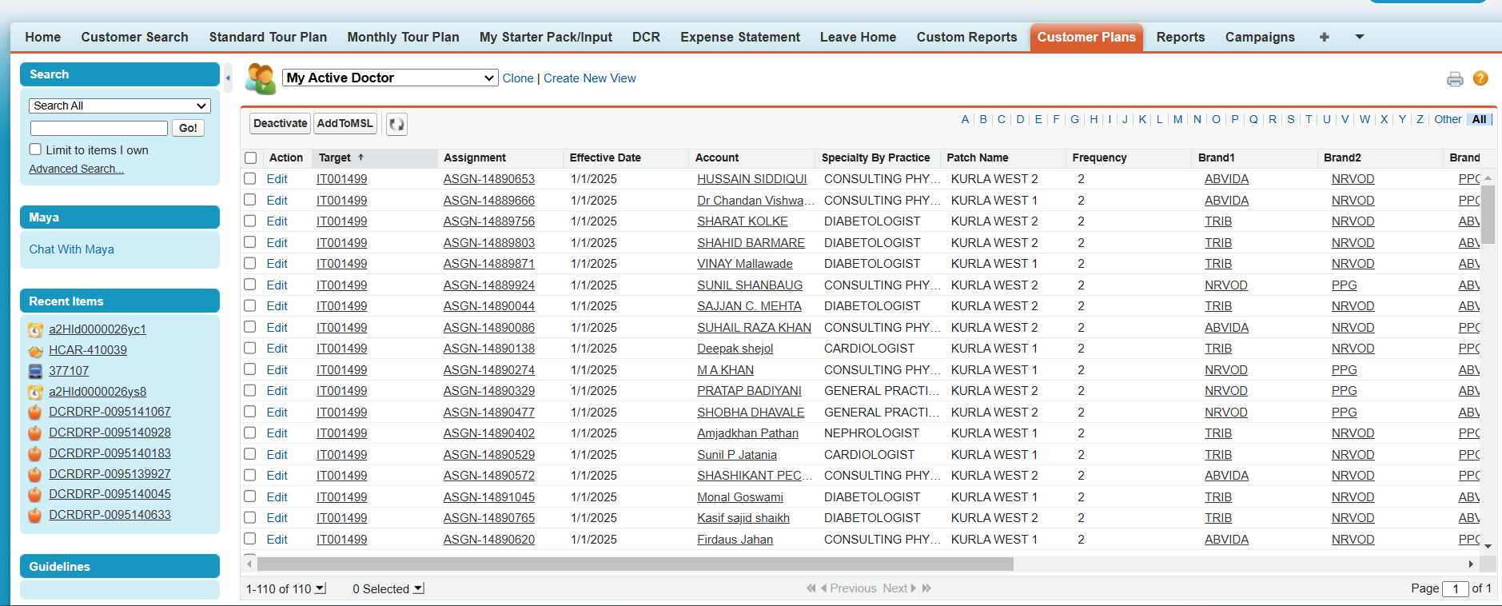
How to update dispatch address on system:
Click on “Customer Plans” tab
Select “My Active Doctor”
Click on Doctor Name

Slide 54
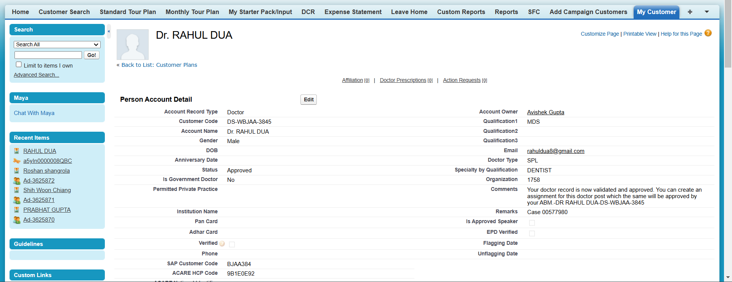
Doctor Profile Page:
Scroll Down

Slide 55
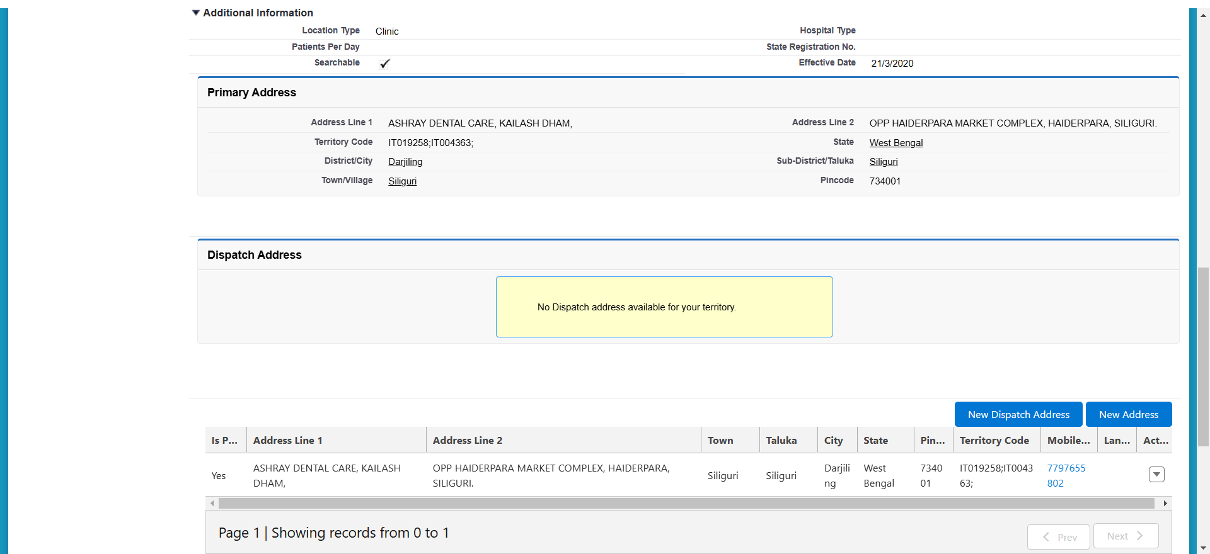
Doctor Profile Page:
Click on “New Dispatch Address”

Slide 56

Doctor Dispatch Address:
Guidelines to update Dispatch Address:
Address 1 (Clinic / Hospital name)
40 chars [Mandatory, no special characters]
Address 2 (House No / Bldg / Apt)
40 chars [Mandatory, no special characters]
Address 3 (Street / Road / Lane)
35 chars [Mandatory, no special characters]
Address 4 (Landmark )
35 chars [Mandatory, no special characters]
Pin Code – Mandatory field.
Town/Village – Auto-populated based on pin code
Sub-District/ Taluka – Auto-populated based on pin code
District/City – Auto-populated based on pin code
State – Auto-populated based on pin code
Enter Address details
Click on Submit

Slide 57

Doctor Dispatch Address:
Dispatch address is saved on Doctor Profile Page
Once a dispatch address is created for a doctor, system will prevent any other user from creating another dispatch address for the same doctor. For any modifications to the Dispatch address, TBM must contact 1Point.
Accuracy of address critical for successful dispatch

Slide 58

Sample Request on ipad:

Slide 59

Sample Request on ipad:
Home Screen ➔ Menu ➔ Sample Request
Sample Request

Slide 60

Sample Request on ipad:
Upon clicking the “Sample Request” option, the system will redirect to the iPad browser, landing on “Input Sample Request Form” page.
Click on “Add Doctors”

Slide 61

Sample Request on ipad:
By default, all specialties in your DVL will be selected
Click on Next

Slide 62

Sample Request on ipad:
You will be able to view the list of all doctors in your DVL
Doctors are highlighted with different color coding
Verified doctors with SAP Customer code missing
Verified doctors with SAP Customer codes are created
Unverified doctors (Not available for selection)
Click on “+” sign to add doctors

Slide 63

Sample Request on ipad:
You will be able to view the list of doctors selected in the “Selected” Section
Before selection, please ensure the dispatch address is updated for the doctor
Click on “Add Doctor”

Slide 64

Sample Request on ipad:
If dispatch address is not updated for selected doctors, then system will show pop up stating “Dispatch address not found for ______. Kindly remove the doctor”.
You need to remove such doctors from the selection list
In such scenario, please update the Dispatch Address from “Doctor Profile” page and then select the doctor to raise sample request

Slide 65

Sample Request on ipad:
You will be able to view selected doctors on the screen with Dispatch address updated in our records

Slide 66

Sample Request on ipad:
For each selected doctor, you need to select brand, SKU and Requested Quantity
To add another brand, click on “Add Brands”
Reason for Request is not a mandatory field
Click on “Add Brands” and enter request details

Slide 67

Sample Request on ipad:
Click on “Add Brands”
To add another brand, click on “Add Brands”

Slide 68
Sample Request on ipad:
If selection is completed, Click on “Submit”
Post request submission, system will not allow to you make any changes

Slide 69

Sample Request on ipad:
Validations as per UCPMP guidelines are built

Slide 70


